Slide 1

RAINFALL PREDICATION MACHINE LEARNING PROJECT

Slide 2

STUDENT INFO:
STUDENT NAME:
SEJAL SANTOSH BHEKARE
IT VEDANT INSTITUTE, THANE

Slide 3
INTRODUCTION
Rainfall prediction using machine learning involves developing models that can forecast patternsbased on various input factors such a historical weather data, atmospheric conditions, and geographical features.
These models employ algorithms to analyze past trends and patterns to make accurate predictions about future rainfall, aiding in weather forecasting and resource management

Slide 4
DESCRIPTION:
In this notebook, we are going to predict whether it will rain tomorrow or not by using various features temperature, windspeed, humidity, pressure, clouds, sunshine, rain today etc
The dataset we are going to use is the Rainfall predication dataset from Kaggle which contains about 1,42,193 rows and 23 columns features.
The dataset contains the labels which we have to predict and the labels are discrete and binary. So the problem we have is a Supervised Classification type.

Slide 5
Motivation:
Accurate rainfall forecasting can significantly impact various sectors such as agriculture,water resource management,disaster preparedness, and urban planning.
project's goal is to contribute towards sustainable development, economic stability and the well-being of communities reliant on weather-dependent activities

Slide 6
COLUMN DESCRIPTION
1 Date The date of observation
2 Location The name of the location of the weather station
3 MinTemp The minimum temperature in degrees celsius
4 MaxTemp The maximum temperature in degrees celsius
5 Rainfall The amount of rainfall recorded for the day in mm
6 Evaporation The evaporation (mm) in the 24 hours to 9am
7 Sunshine The number of hours of bright sunshine in the day.
8 WindGustDir The direction of the strongest wind gust in the 24 hours to midnight
9 WindGustSpeed The speed (km/h) of the strongest wind gust in the 24 hours to midnight
10 WindDir9am Direction of the wind at 9am
11 WindDir3pm Direction of the wind at 3pm
12 WindSpeed9am Wind speed (km/hr) averaged over 10 minutes prior to 9am
13 WindSpeed3pm Wind speed (km/hr) averaged over 10 minutes prior to 3pm
14 Humidity9am Humidity (percent) at 9am
15 Humidity3pm Humidity (percent) at 3pm
16 Pressure9am Atmospheric pressure reduced to mean sea level at 9am
17 Pressure3pm Atmospheric pressure (hpa) reduced to mean sea level at 3am
18 Cloud9am Sky obscured by cloud at 9am.
19 Cloud3pm Sky obscured by cloud at 3pm.
20 Temp9am Temperature (degrees C) at 9am
21 Temp3pm Temperature (degrees C) at 3pm
22 RainToday whether it rained today or not
23 RainTomorrow whether it will rain today or not

Slide 7
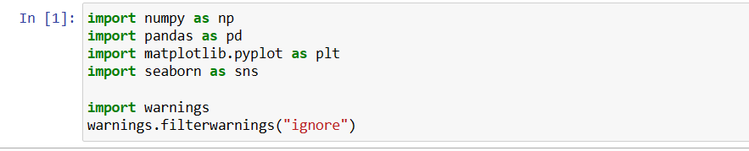

Load libraries

Slide 8
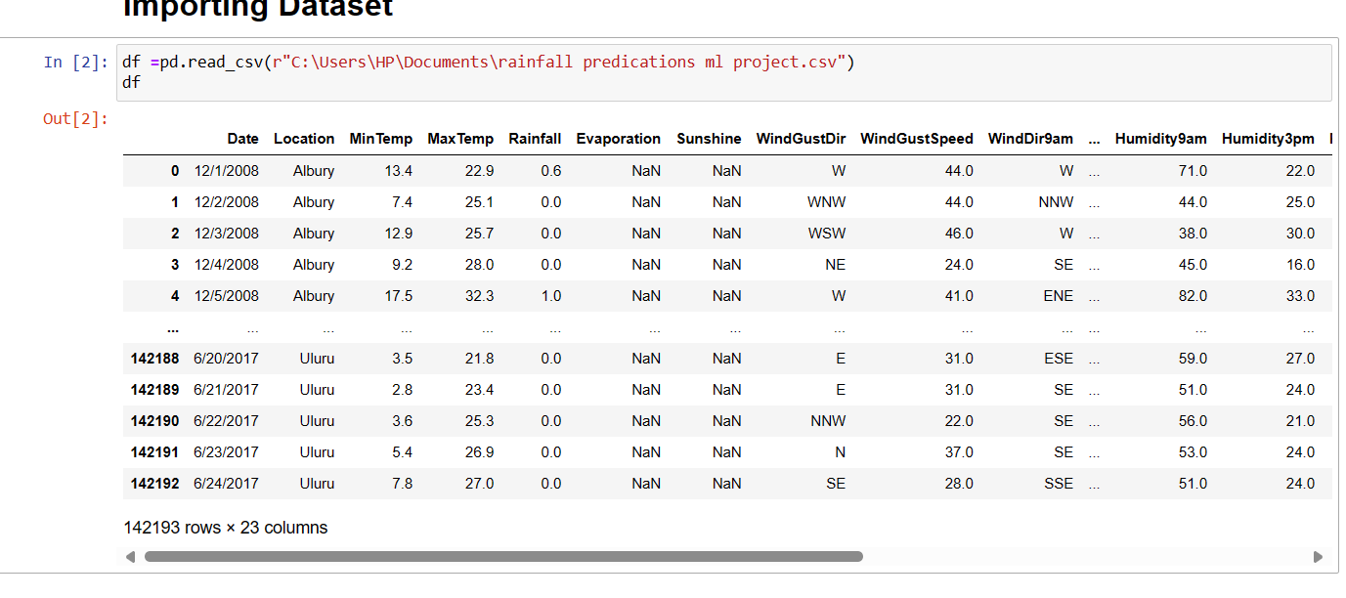
Importing Dataset

Slide 9
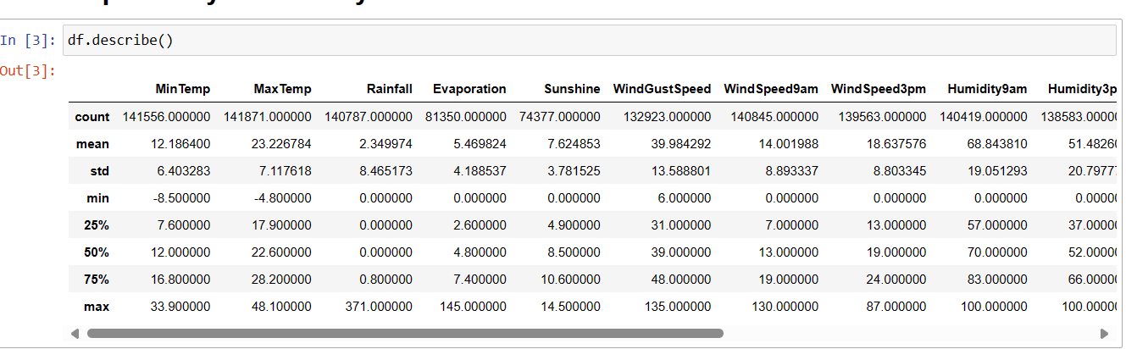
Exploratory Data Analysis
Describe() Function returns statistical description of the data in the DataFrame ex. Mean, mode, average, standard deviation

Slide 10
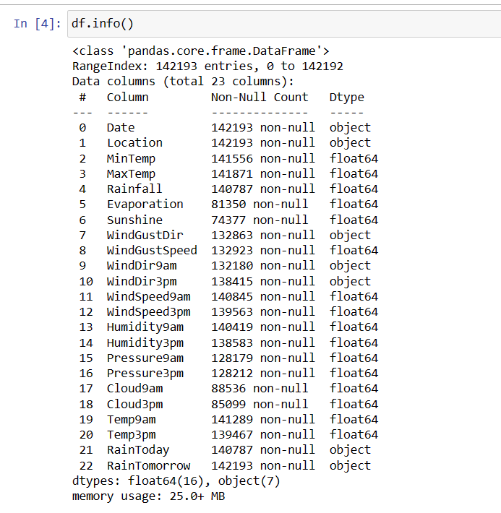
Info() function returns The information contains the number of columns, column labels, column data types, memory usage, range index, and the number of cells in each column

Slide 11
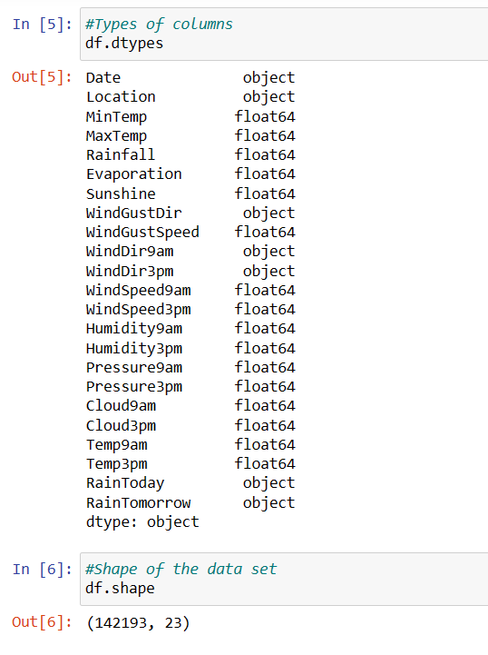
dtype)() function
It gives Datatype of all columns

Slide 12
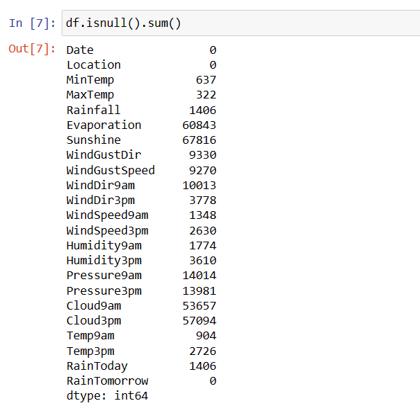
Checking null values
To count the number of null values in a Pandas DataFrame, The function df.isnull(). sum()returns the number of missing values in the dataset.

Slide 13
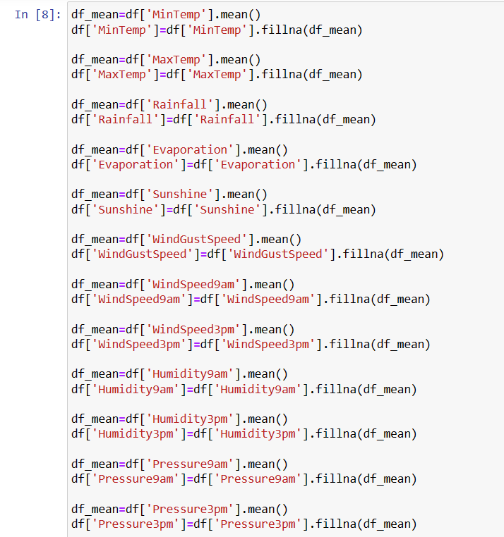
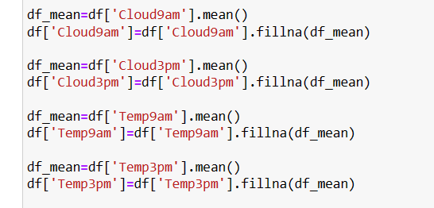
For replacing Numerical Columns Taking mean of the column which has null value and replace with mean

Slide 14
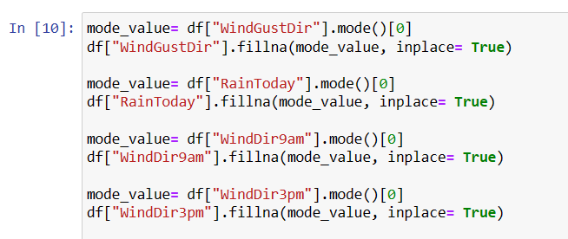
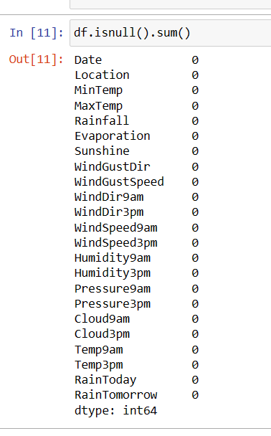
For replacing Oject Columns Taking mode of the column which has null value and replace with mode
Now we can see here,
All null values are replace with their mean and mode values and now no null values are present in df

Slide 15
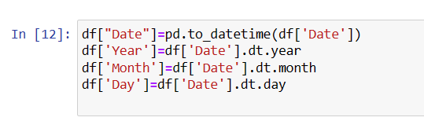
Feature Engineering
For visualization we split the "date" column into 3 new columns which is "day", "month" and "year" without droping an original column

Slide 16
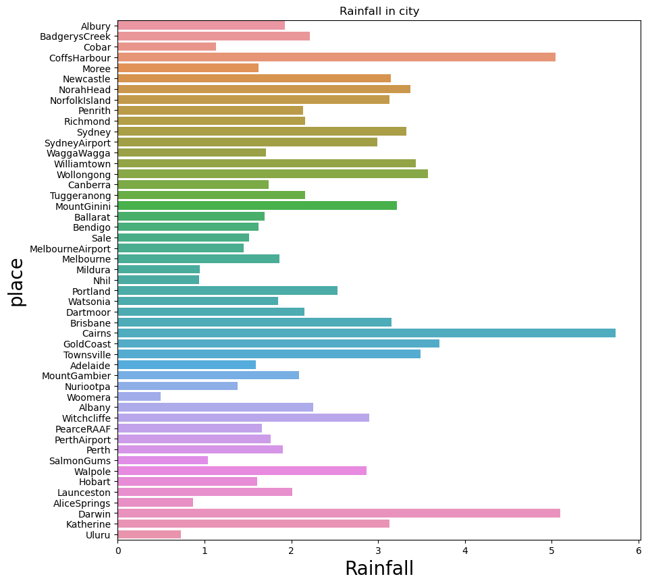
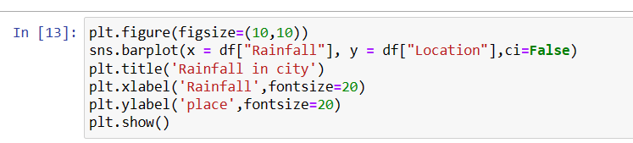
VISUALIZATION

Slide 17
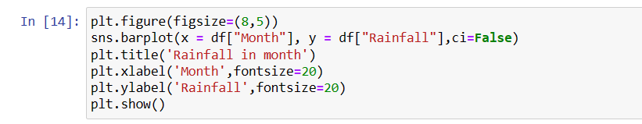
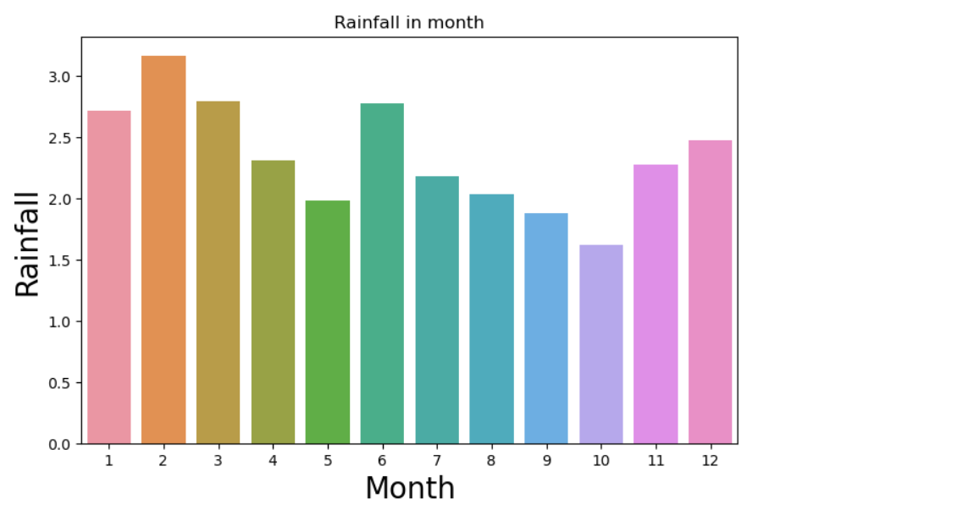

Slide 18
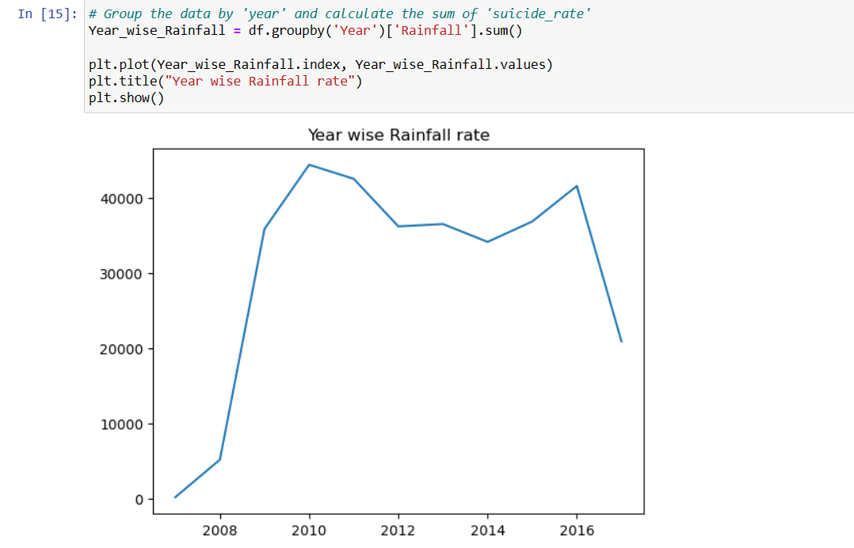

Slide 19
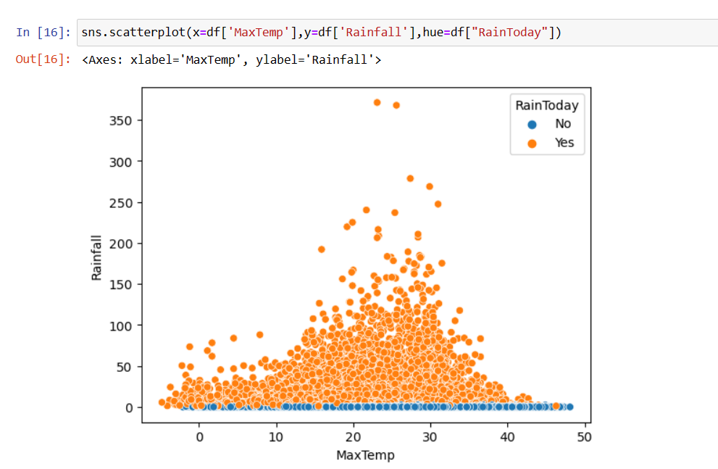

Slide 20
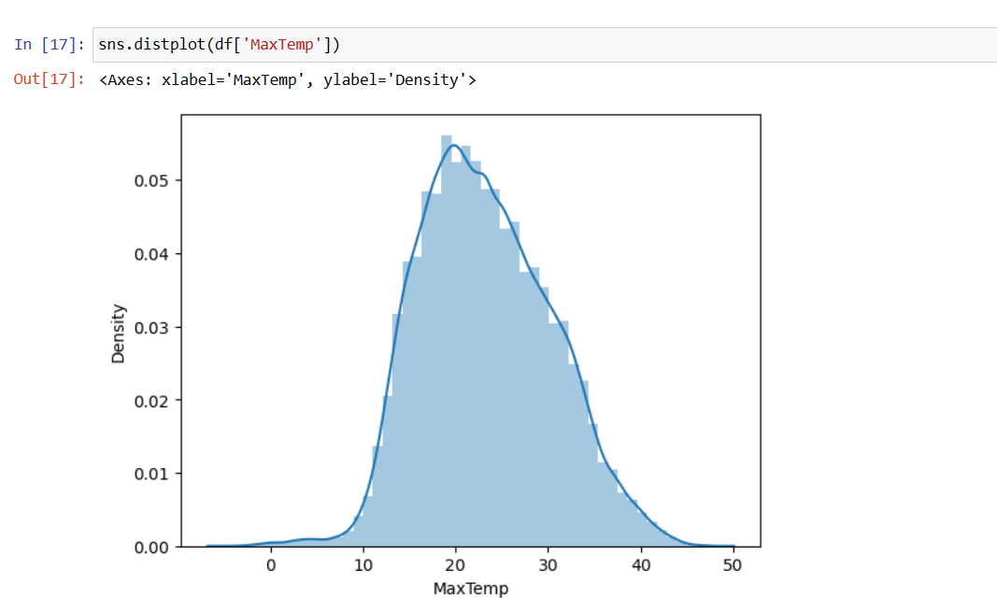

Slide 21
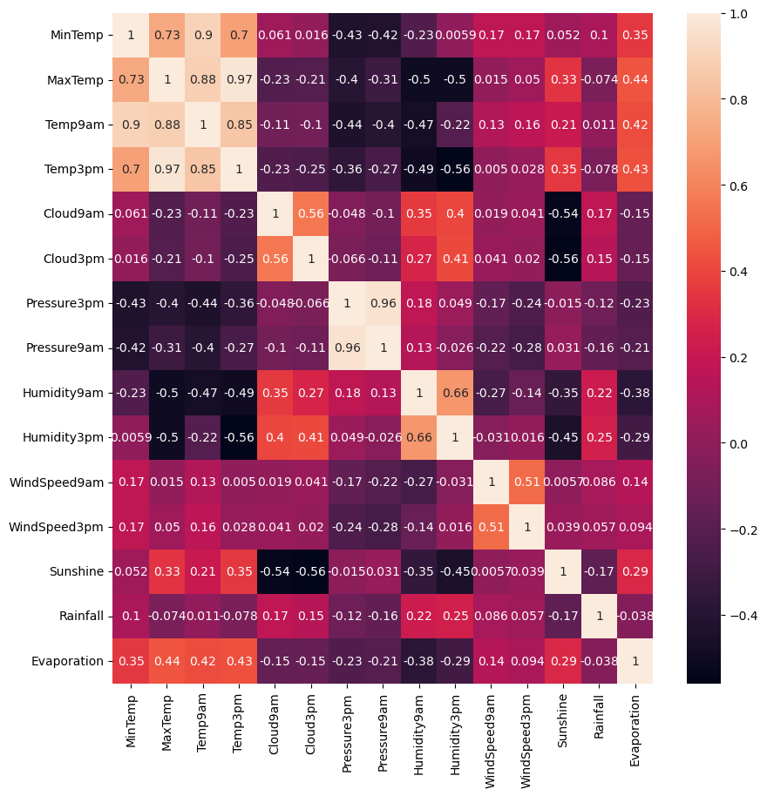
Heatmap Shows The Relationships Between Columnsone Plotted On Each Axis

Slide 22
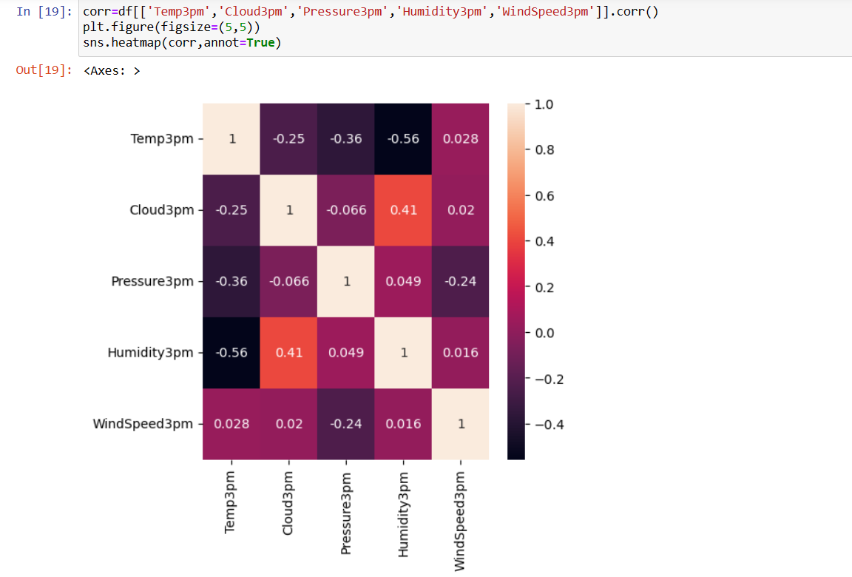


Slide 23
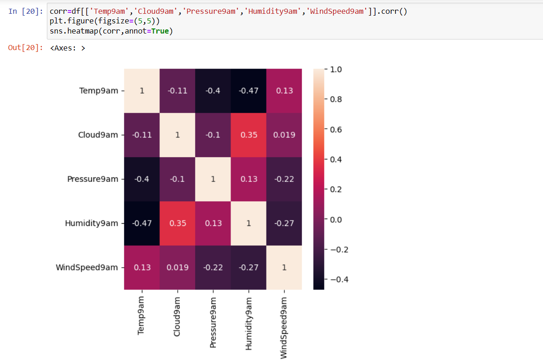


Slide 24
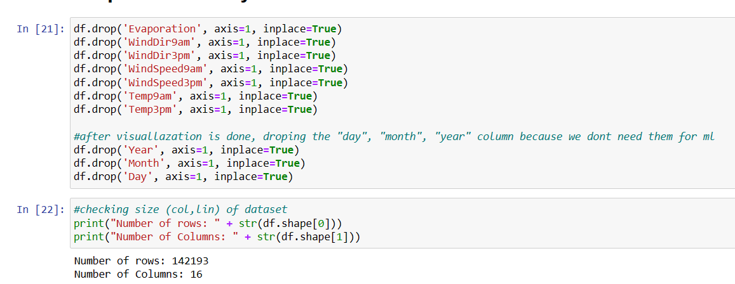
Drop Unnecessary Columns

Slide 25
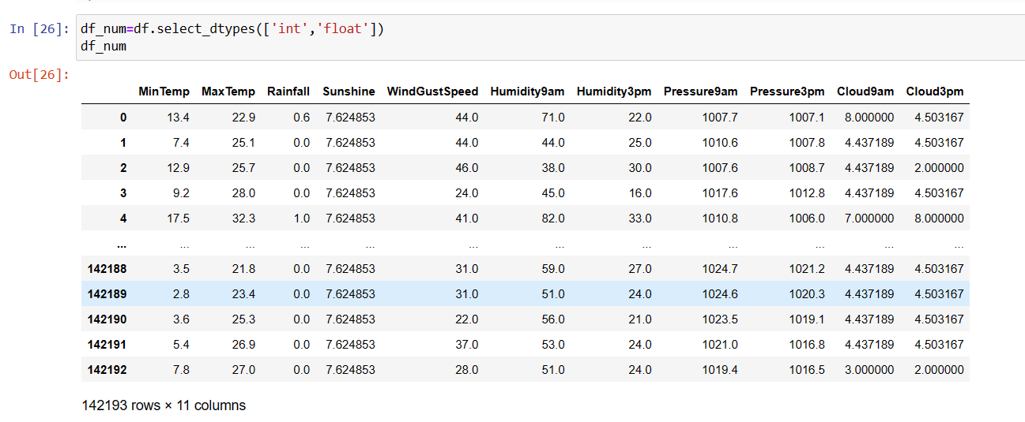
Separting Numeric And Category Data
Numerical columns

Slide 26
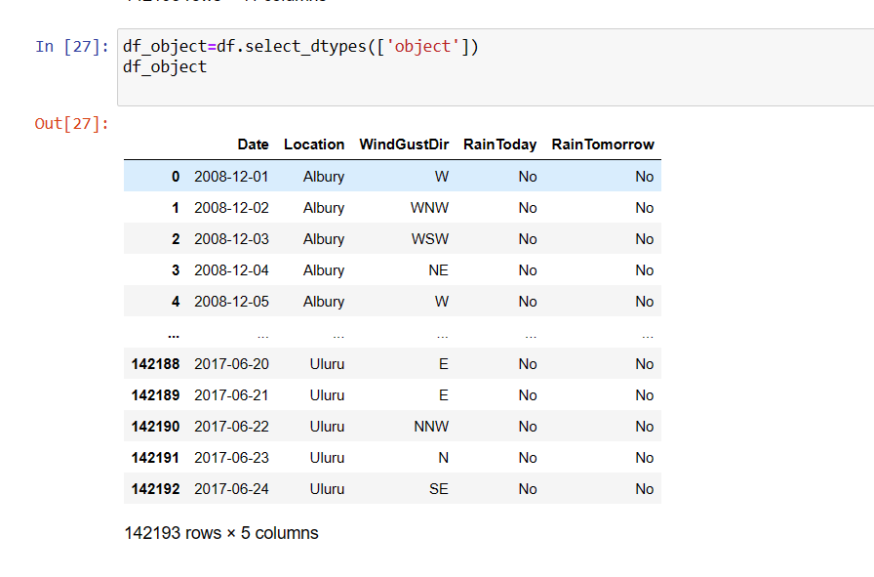
Categorical column

Slide 27
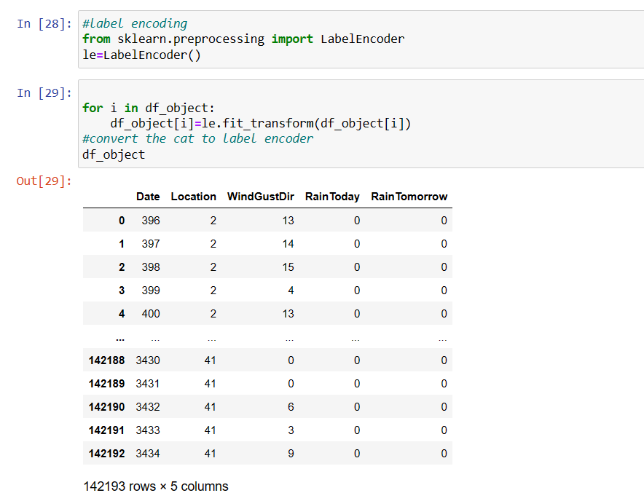
Using label encoder for converting categorical data into numeric

Slide 28
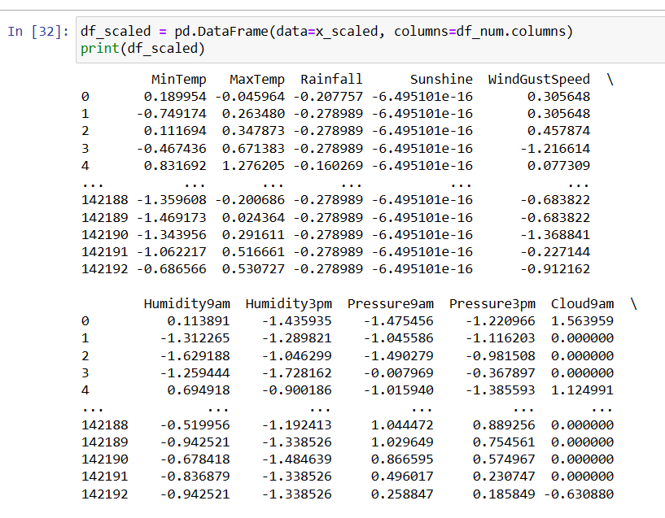
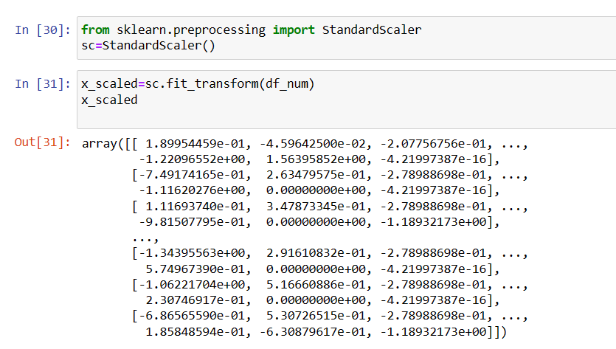
Feacture Scalling

Slide 29
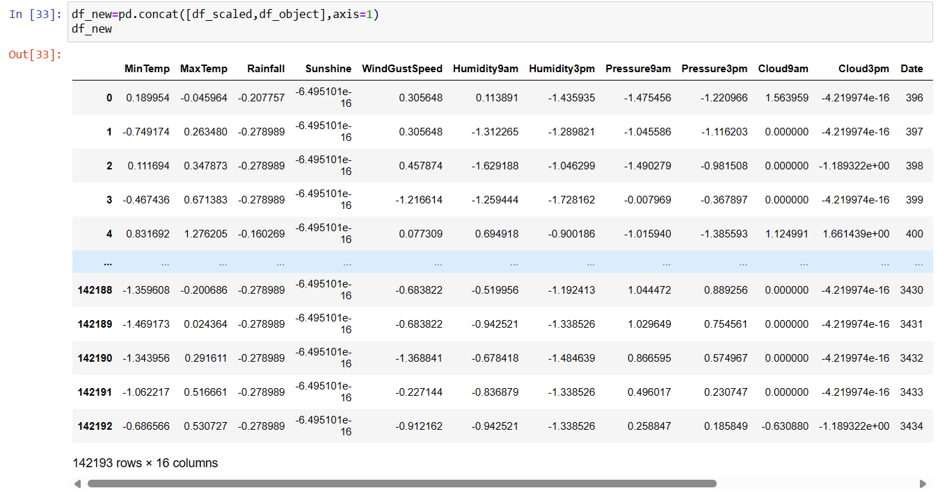
Concatenate Numerical and Categorical Columns

Slide 30
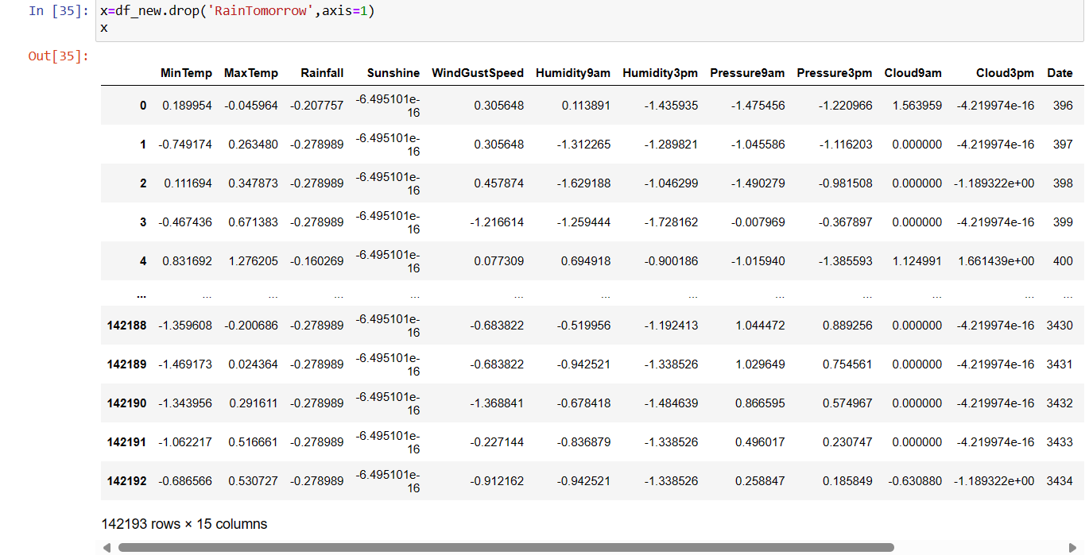
Spiliting X And Y
X columns

Slide 31
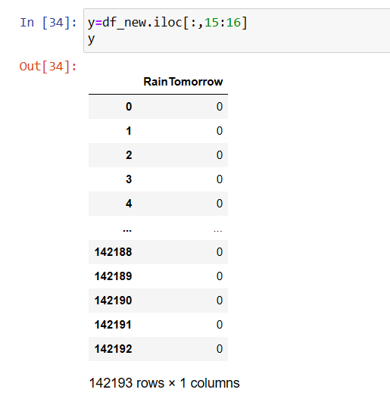
Y Column (Target Column)

Slide 32
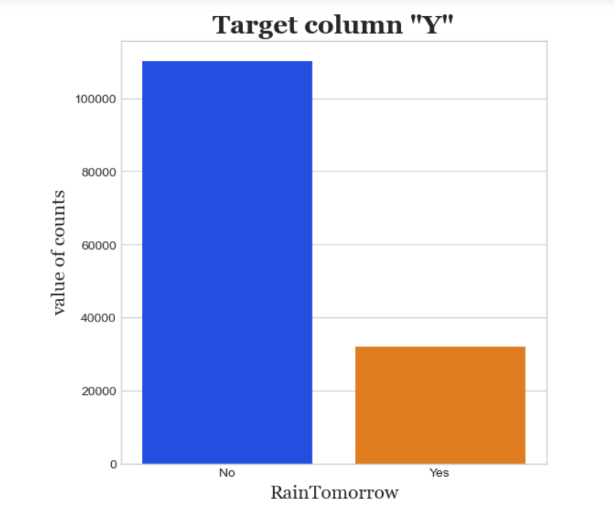
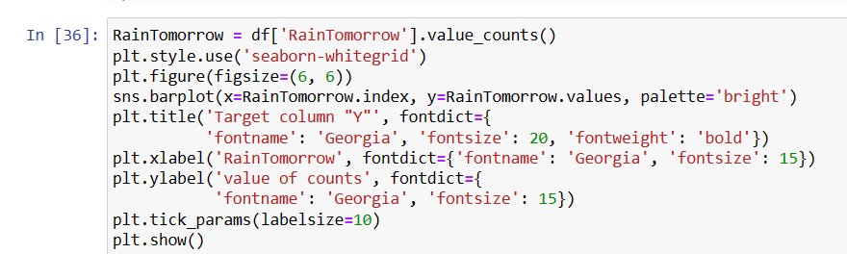
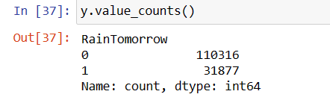
Imbalanced data

Slide 33
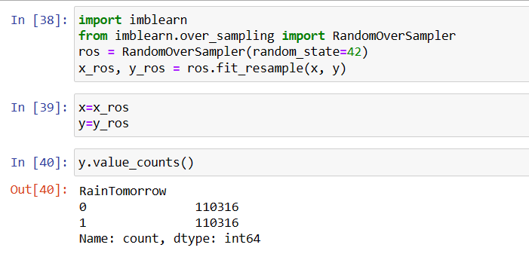
Since the Data is imbalanced , need to do sampling (either Oversampling or Undersampling
Now Y Column (Target Column) Is Balanced

Slide 34
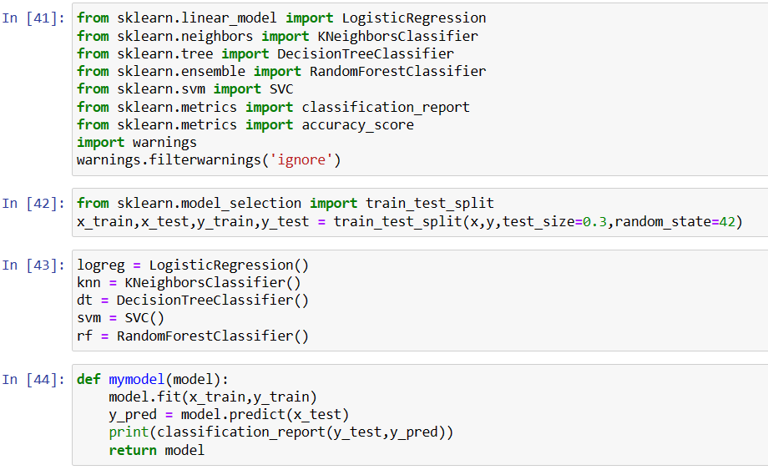
Importing the models and Train them

Slide 35
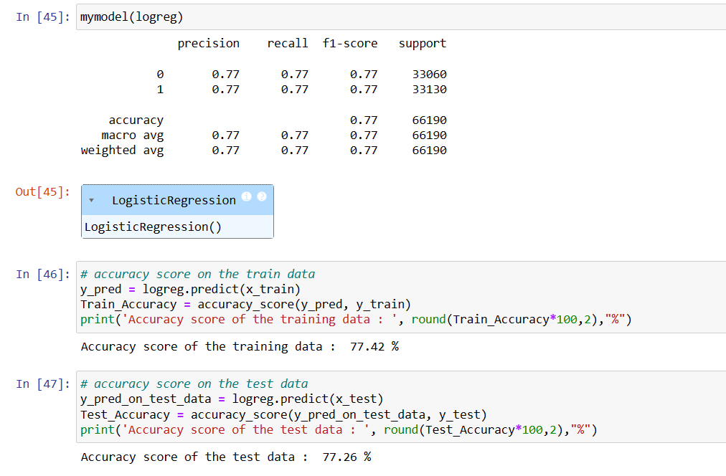
Logistic Regression

Slide 36
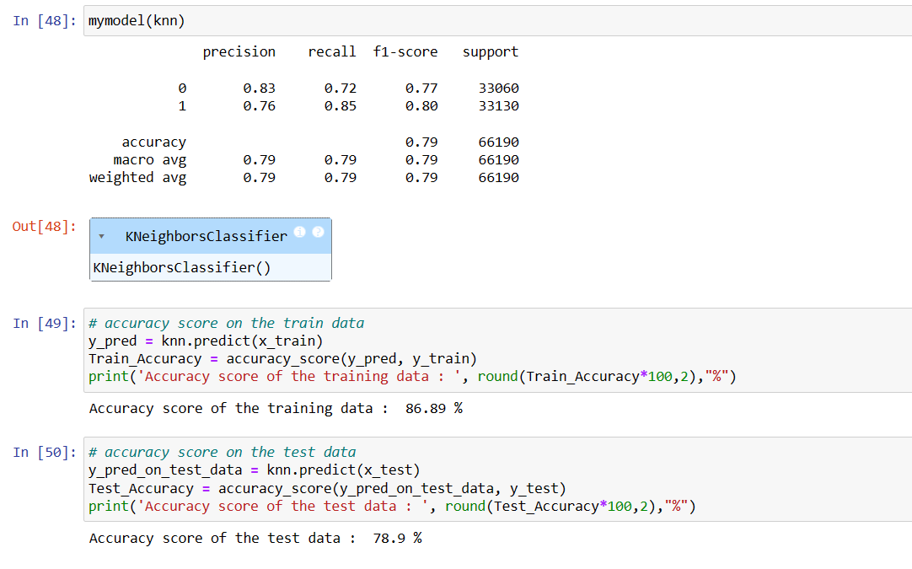
KNeighborsClassifie

Slide 37
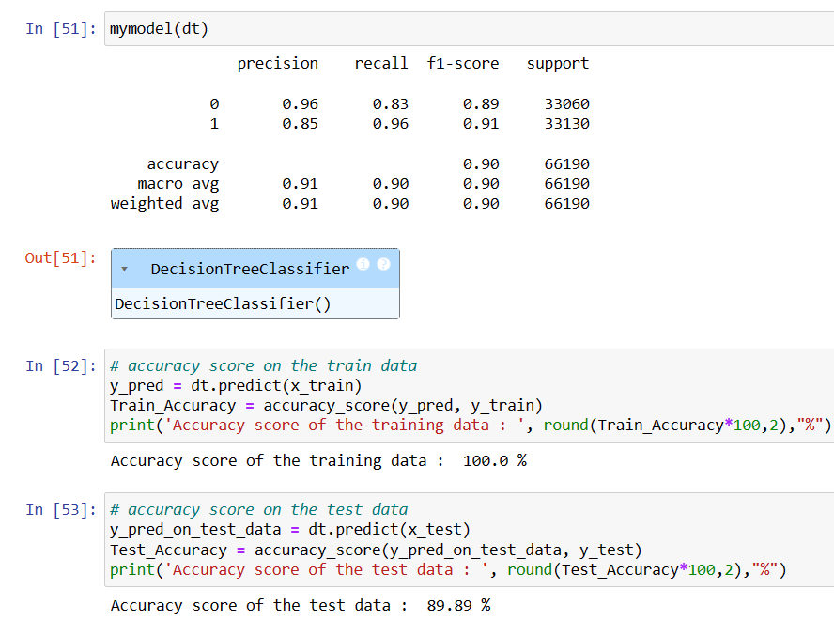
Decision Tree

Slide 38
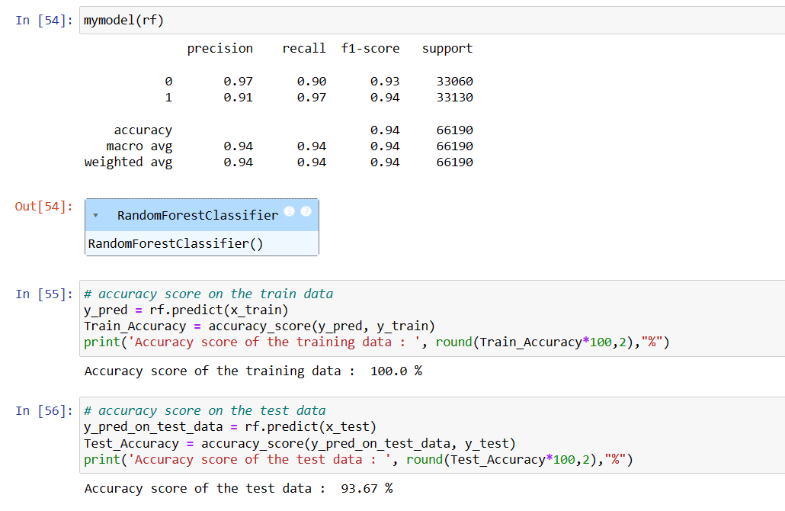
Random Forest

Slide 39
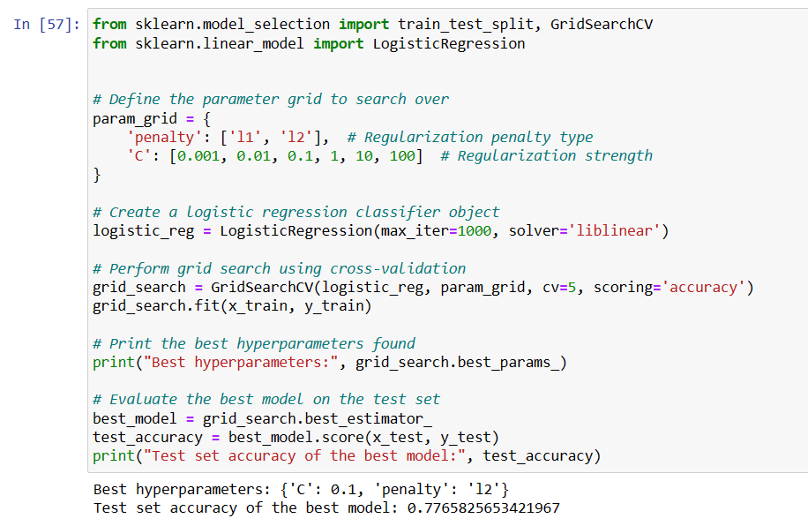
GridSearchCV LogisticRegression

Slide 40
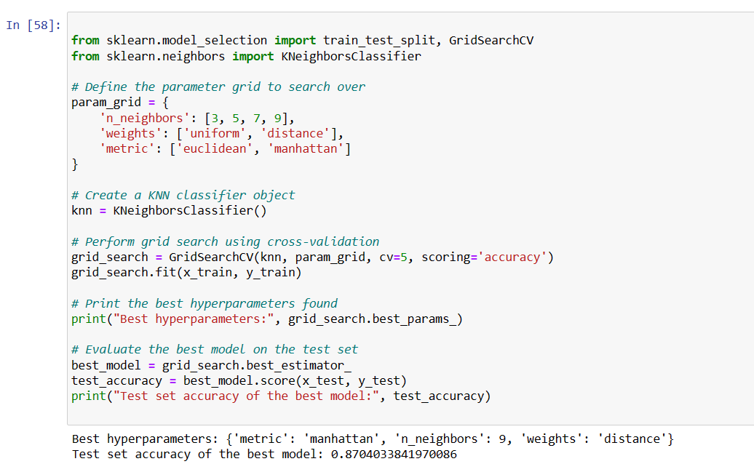
GridSearchCV KNeighborsClassifier

Slide 41
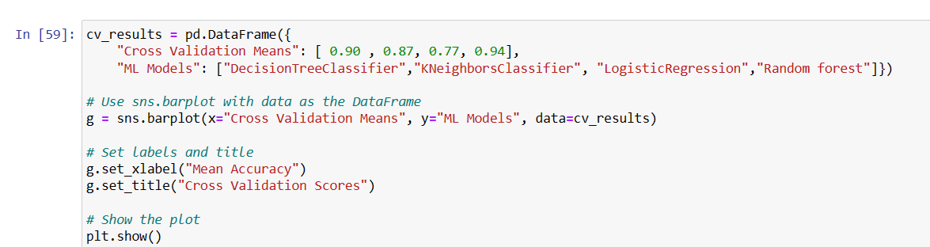
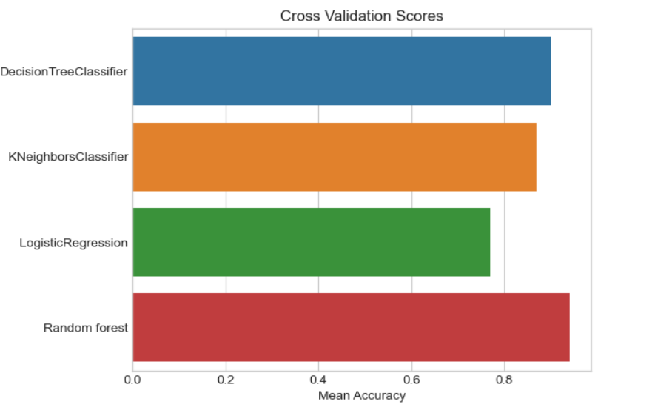
CONCLUSION
In this project, we build various models like logistic regression, knn classifier,decision tree classifier, random forest & svm
A Random Forest gives the highest accuracy score of percent among all the ML Models,So for the Rainfall prediction Random Forest Classifier is best model
​

Slide 42

This template was created in cooperation with scientific presentations expert Melissa Marshall. This template will help those presenting technical information be more understandable and engaging by using an “assertion/evidence” strategy. For more information, visit her website or listen to her TED talk.​ ​ Melissa’s approach is also informed by Michael Alley’s book, The Craft of Scientific Presentations.​
THANK YOU

